Slide 1
Offensive Security

Slide 2
What is Offensive Security?
Subset of the security field focusing on assessing the security of machines/networks by attempting to attack them
Proactive instead of reactive

Slide 3
Why do we do it?
Approach your network from the mindset of an attacker
Look at the difference between how your network is supposed to be, and how it is
It’s fun

Slide 4
Penetration Testing vs Red Teams
Penetration testing is a time-bound assessment with the goal of finding as many vulnerabilities and misconfigurations as possible, along with the potential impact of those findings (eg. Domain Admin)
Red team assessments are not scoped to find as many vulnerabilities as possible, but to test the detection and response capabilities of the blue team
Can emulate specific threat actors in the organization’s threat model
Penetration tests are usually from outside consulting organizations, and red teams are usually internal to a company.
Notes:
Those internal external lines are very blurry however, spectreops consults on more red team engagements for example. But in general, red team

Slide 5
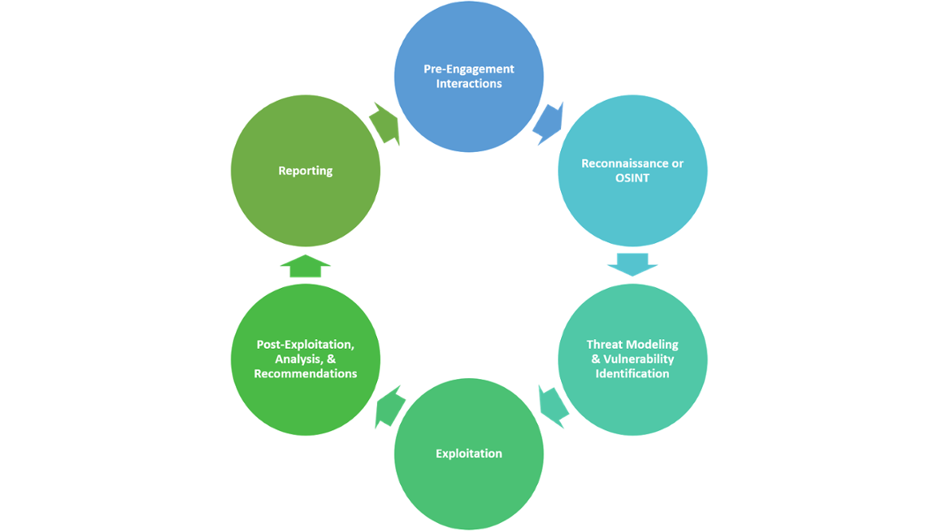
Penetration testing lifecycle
Broadly defined phases of an assessment
A key part of penetration testing is reporting
Notes:
For our purposes the penetration and red team lifecycles are pretty similar

Slide 6
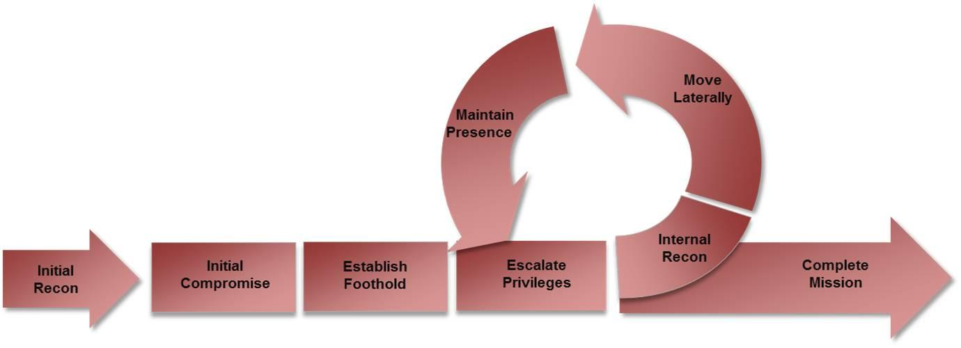
Attacker Lifecycle
Notes:
So how does the offensive security model compare to an attacker in the real world?
They’re really very similar, the attacker just has different objectives, they have concrete goals, they have data they want to exfil, etc

Slide 7
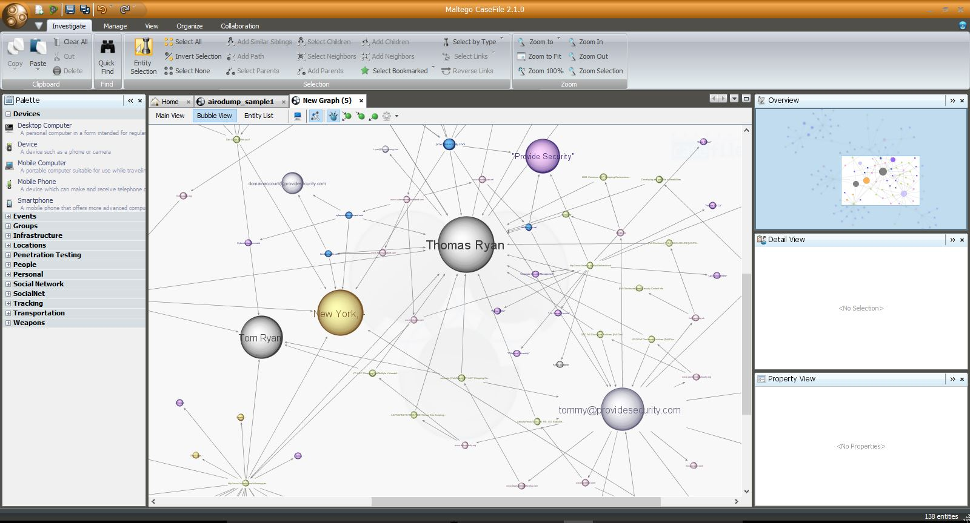
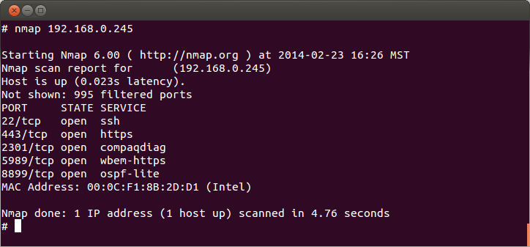
Reconnaissance
Involves gathering information about the target
This information can be technical information or business information
This can often be collected without any chance of the target detecting it
Notes:
So lets look a little closer at each phase
Recon, gathering information about the target
This can be technical - network information gathered from scans, things like that.
Or business - OSINT, employees, positions, job reqs, postings for technologies that they use, etc
The goal is to get you information you can use to get in, that could be specific technologies they use, passwords on trello boards exposed to the internet

Slide 8
1.5 Enumeration
The goal in this stage is to identify exactly what versions of which services are running
Look for known exploits to which those specific versions are vulnerable
Are there common misconfigurations which show up a lot with these specific technologies?
How do you test for these misconfigurations?
Notes:
Enumeration and reconnaissance are the most important parts of an attack, without laying the groundwork properly, you will be unlikely to suceeed long term

Slide 9
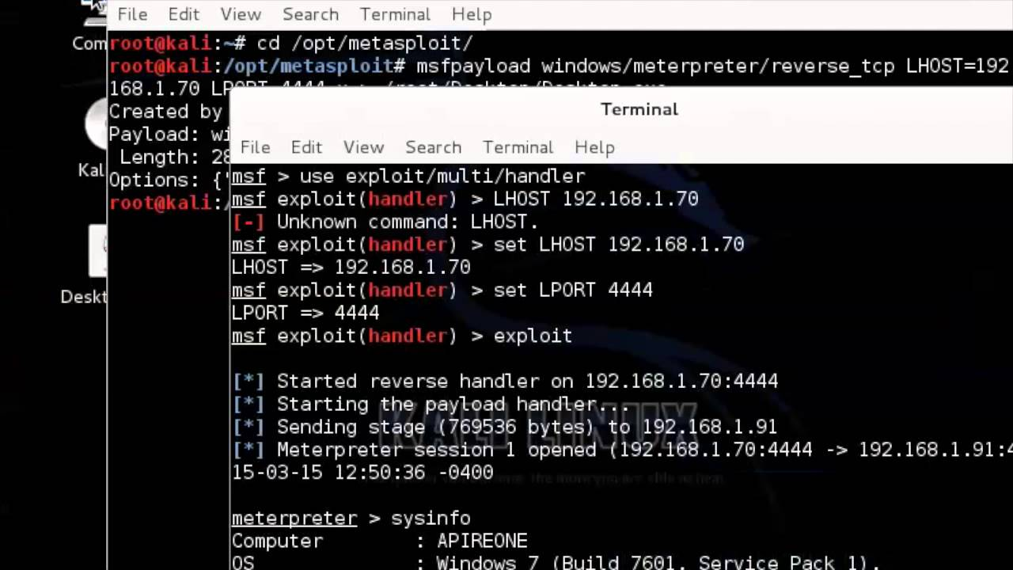
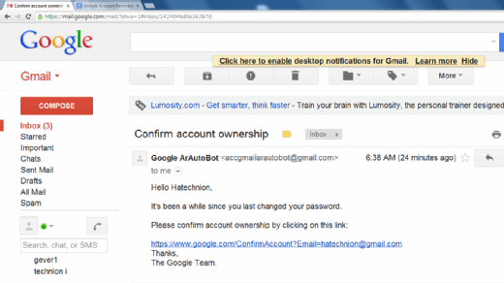
2. Compromise
Actually breaking into machines, often what people think about when thinking of “hacking”
Notes:
This is the flashy shit everyone thinks of
A lot of the time though, it’s really dumb, people click on links, or open documents and get popped
It only takes one weak link to own an enterprise
This is why client side exploits are still a think (anyone have a word exploit they want to sell me?)

Slide 10
3. Persistence
After you initially gain access into a network, you want to make sure you can always get back in
This doesn’t just mean in 5 minutes, it means days, weeks, or months later
Through reboots, resets, etc
This is going to be a huge part of CDE for the red team
Notes:
This is what those of you who are playing CDE are going to have to worry about. You should assume we will get in
Now you need to figure out how we want to stay in
This is where half of your effort should be focused, half should be on how you secure a system and lock things down, the other half should be on trying to find where we’ll try and hide once we are in

Slide 11
4. Post Exploitation
This is what really separates the skilled attackers from the script kiddies, and the good penetration testing consultants from the thinly veiled scam artists
What can you do with your access?
Can you escalate privileges on your local machine?
What is accessible within the network?
Can you get access to file servers, internal source code, business documents?
Can you get access to other users’ machines?
Can you elevate your privileges on a network level? To Domain Administrator?
How easy is it to stay undetected?
Notes:
This is what seperates the shitty idiots from the APTs (APT sqordfish on saturday? :) )
Instead of just popping a box, you then go on to figure out what you can do with the box you just popped.

Slide 12
Metasploit
Widely known attack framework, written in Ruby
Walks you through the major steps in launching an attack
Choosing and setting up an exploit
Checking to see if the target is vulnerable
Choosing and configuring a payload
Choosing the encoding and evasion techniques for the payload
Launching the attack
Handling the connections (This is extremely useful)
Very much a “point-and-click tool”

Slide 13
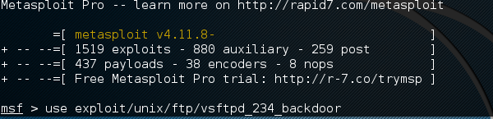
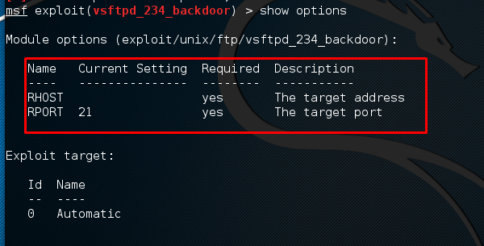
Metasploit 101
Console driven application
Simply run msfconsole in kali to start it - may require the database to be initialized
Notes:
Metasploit is a command line tool, run msfconsole to start it, it might complain if the postgres database which backs it is not initialized.
The basics of metasploit are very simple, it tab completes, so you can start typing use exploit/unix tab to list all the options.
You select an exploit to use with the use command then show options will show you all the variables to set to launch the exploit
It really holds your hand, which is why its a very commonly used script kiddie tool

Slide 14
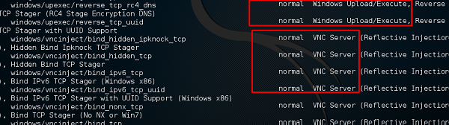
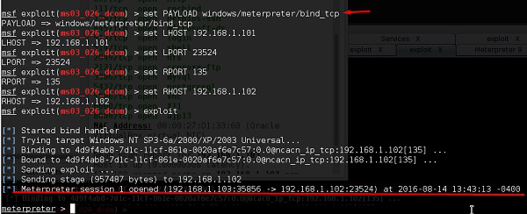
Metasploit 101 - Cont’d
Notes:
You then select a payload, select the payload options, and execute, if everything works correctly, you will have a shell on the machine where you can type commands as if you were sitting at the keyboard in front of it

Slide 15
Payloads
Payloads are the code delivered by an exploit
Generally with the goal of taking the code execution granted by an exploit and turning it into actual access to the system
As payloads are the first step after exploitation, there are several common categories
Bind Shells
Reverse Shells
Payloads can be single-staged or multi-staged
Notes:
What are payloads?
Bind shells and reverse shells can be further broken down into tcp, udp ,http, etc - eg the protocol they operate over
They can either be native code, or scripting langugages like PHP, ruby, powershell
Payloads can be 1 component, or smaller components which download each other to finish the job, staging themselves.
Delivering a payload is the ultimate goal of an exploit, and is how you get your nice shells and connections to a victim machine

Slide 16
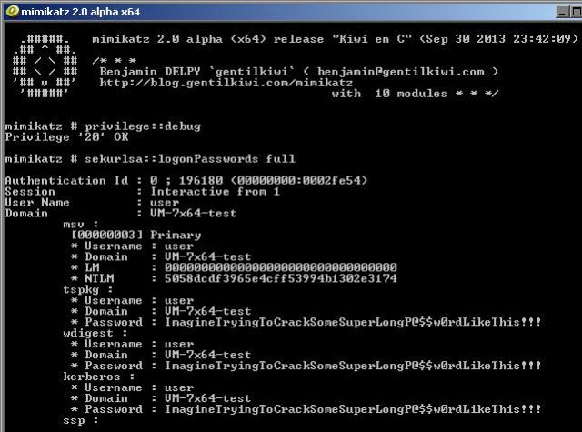
Mimikatz
Mimikatz is a tool which can dump Windows passwords from memory.
In plaintext
And for every user who logged in since the last boot
This should scare you
Notes:
Requires administrator privileges
This is one of the most useful tools in the penetration testers arsenal, it makes it much easier to move laterally once you’ve penetrated one box to others in the network.

Slide 17
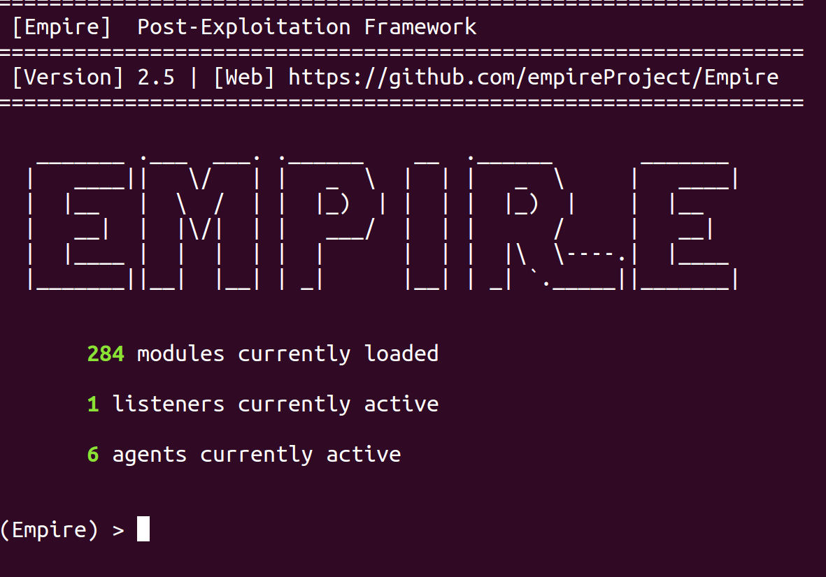
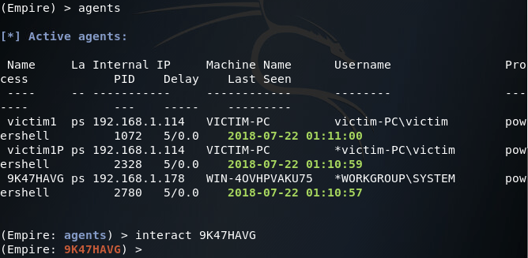
Powershell Empire
Empire is the post-exploitation version of metasploit
Its purpose is maintaining access within a target
Agents written in powershell and python
Notes:
Empire is the version of metasploit for after you’ve compromised a target
It helps you maintain access with “agents” - post exploitation code which periodically calls back and retrieves tasks for you to run. This helps avoid constant communication which is easier to catch when monitoring the network

Slide 18
Remaining undetected
An attacker usually wants to remain undetected in a network until they accomplish their goal
How to do this?
Minimize network traffic
Minimize CPU usage
Minimize active time on the network - try to schedule things when they will blend in
Persist in services or inside of normal processes instead of something obvious
Notes:
One of exceptions to his rule is there was an intrusion attributed to russia which fireye/mandiant investigated, and when they found out the the defenders were on to them, they dug in and basically fought to stay in the network instead of hiding. I believe the defcon talk on WMI stuff from fireeye a couple years back is the one which covers this.

Slide 19

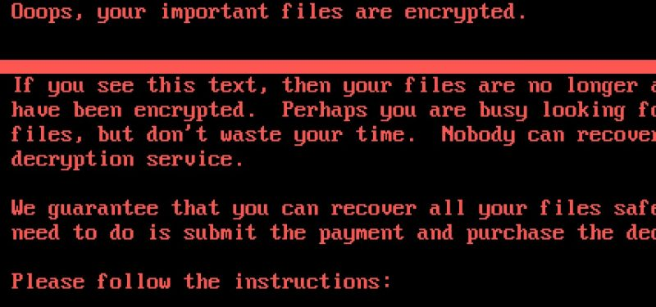
What if they don’t want to hide?
Ransomware, disk wipers, DDOS attacks, attempted physical damage to servers, etc
Those can be end goals for the attackers, too
Notes:
Stuxnet is the obvious example, ukrainian power grid, the malware which wiped the saudi oil companies computers
Ransomware is turning into a whole industry too - take over a persons network and hold it hostage for money
We won’t be hiding at CDE for long, the goal is for us to be active enough that you can see our effects, and that we leave enough traces for you to find us.

Slide 20
Lab
Download the OVA from https://download.vulnhub.com/metasploitable/Metasploitable.zip
Install this into virtualbox, and boot it, along with your kali VM
From your kali VM, run a nmap scan to find the IP of the metasploitable box
Start enumerating services and vulnerabilities and try to break in
THIS IS TO EASE YOU INTO THE HOMEWORK ASSIGNMENT, completing the lab is to your benefit.

Slide 21
But what if you can’t just run someone else’s script?
Metasploit is great if the system is vulnerable to something metasploit has a payload for
But it doesn’t have a payload for everything
Think about CDE with the lol.co program
There’s no Metasploit payload for that
But the red team still could exploit it

Slide 22
Welcome to Pwn
Many different types of vulnerabilities in binaries:
Stack buffer overflows
Heap buffer overflows
Format string bugs
Unlink Corruption
Use After Free
Command Injection
And many many more
If you’re interested in these come to our Spring meetings!

Slide 23
Now we have a demo
Because seamus was too lazy to make slides

